Slide 1
ScRNAseq analysis of lung interstitial macrophages
20211108
BAI Qiang

Slide 2
BACKGROUND

Slide 3
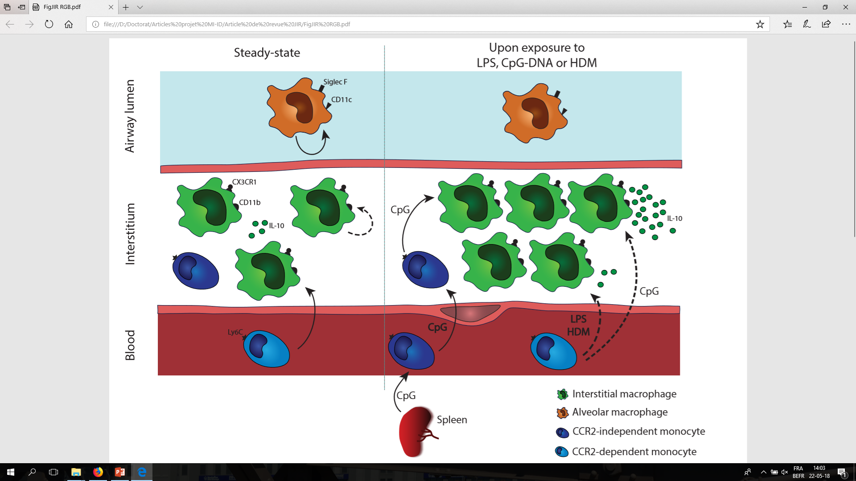

Schyns J et al., JIR (2018)
Sabatel et al., Immunity(2017)
Notes:
In mouse lung, the well-known alveolar macrophages (AM) differentiate from fetal monocytes, are maintained by self-renewal and are specialized in removal and recycling of surfactant molecules. Besides AM, the interstitial macrophages (IM), have been shown to contribute to lung immune homeostasis by producing the immunosuppressive cytokine IL-10 and preventing the development of aberrant type 2 allergic responses. In addition, they may contribute to reducing the risk of asthma in a microbe-rich environment. Indeed, we have reported that exposure to bacterial CpG expands tolerogenic IM from monocyte precursors, thereby conferring robust protection against allergic asthma.
(IL-10-producing IM have also been described in humans, and clinical evidence suggests that they may be functionally impaired in asthmatic patients.)
15

Slide 4
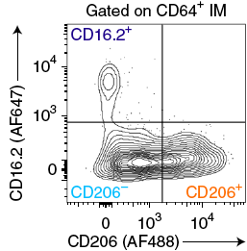
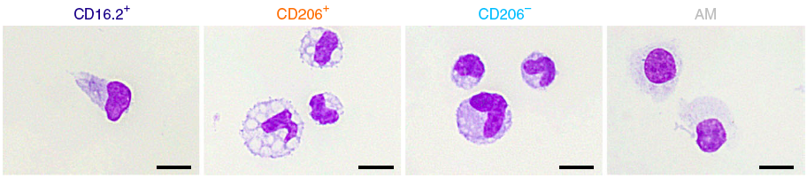
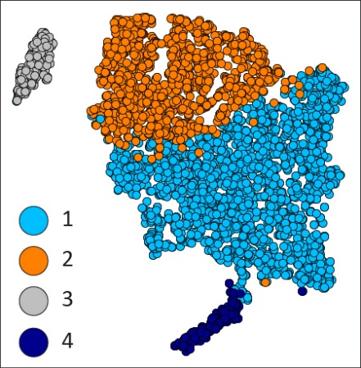
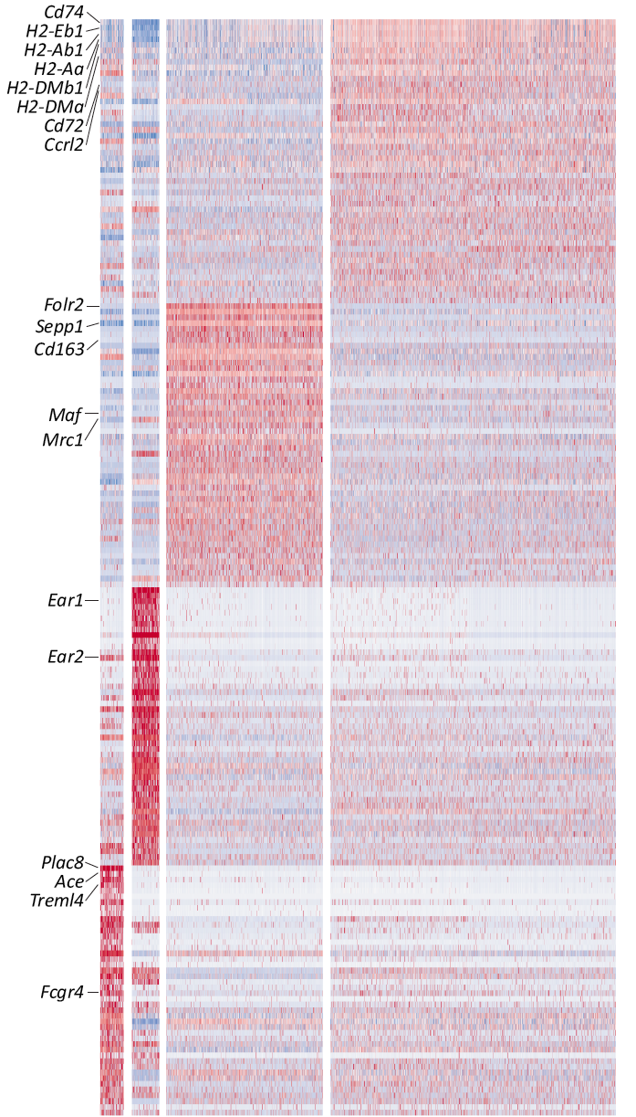
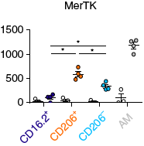
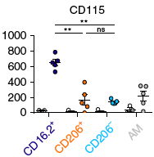
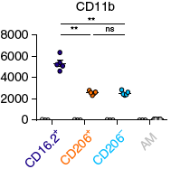
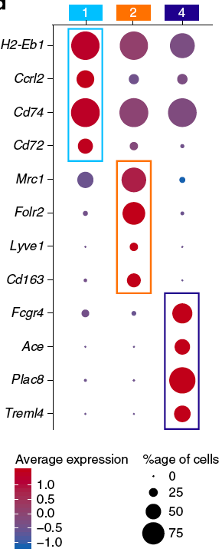
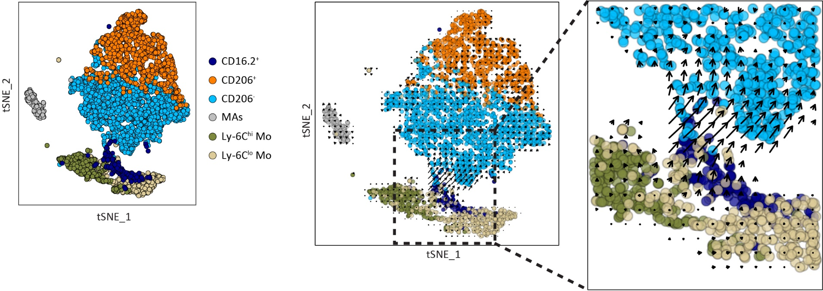
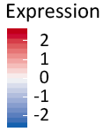
Subsets of CD64⁺ IM identified in mouse lung
AM
tSNE_1
IM
tSNE_2
Normalized MFI
(MHC-II)
(CD206)
(CD16.2)
4
3
2
1
Schyns, et al. Non-classical tissue monocytes and two functionally distinct populations of interstitial macrophages populate the mouse lung. Nature Communications, 2019

Slide 5
New strategies to “hunt” the subtle transit monocytes-IM differentiating cells

Slide 6
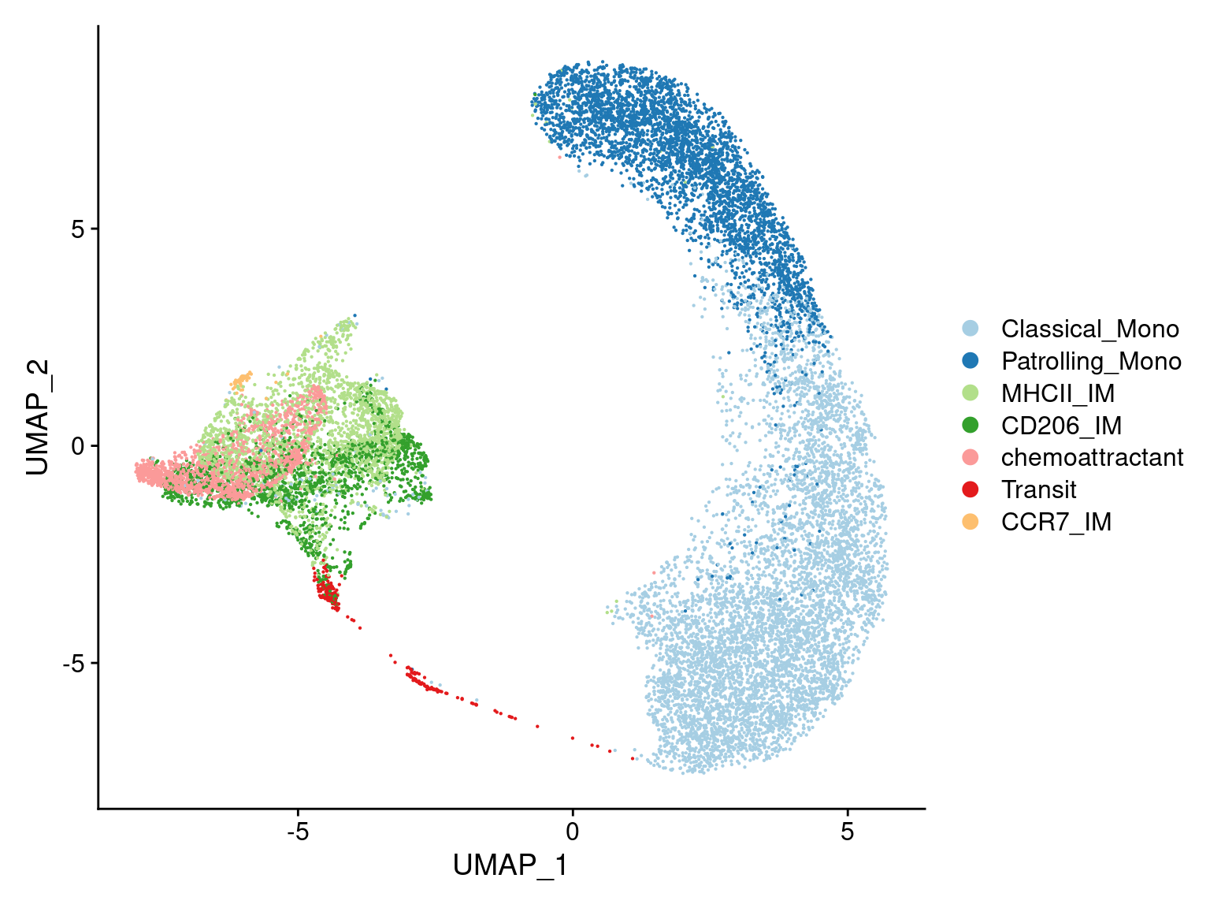
“Hunting” for transition cells during monocyte-IM differentiation
! WANTED !
”Hunting” strategies:
Accelerate differentiation by induced empty niche;
Enrichment of extra-vasculating cells;
Barcoding samples from different time points and sequence pooled sample;
Increase sequencing depth by higher cell number and reads per cells.
Notes:
15

Slide 7
ScRNAseq of empty niche-driven monocyte-IM differentiation

Slide 8
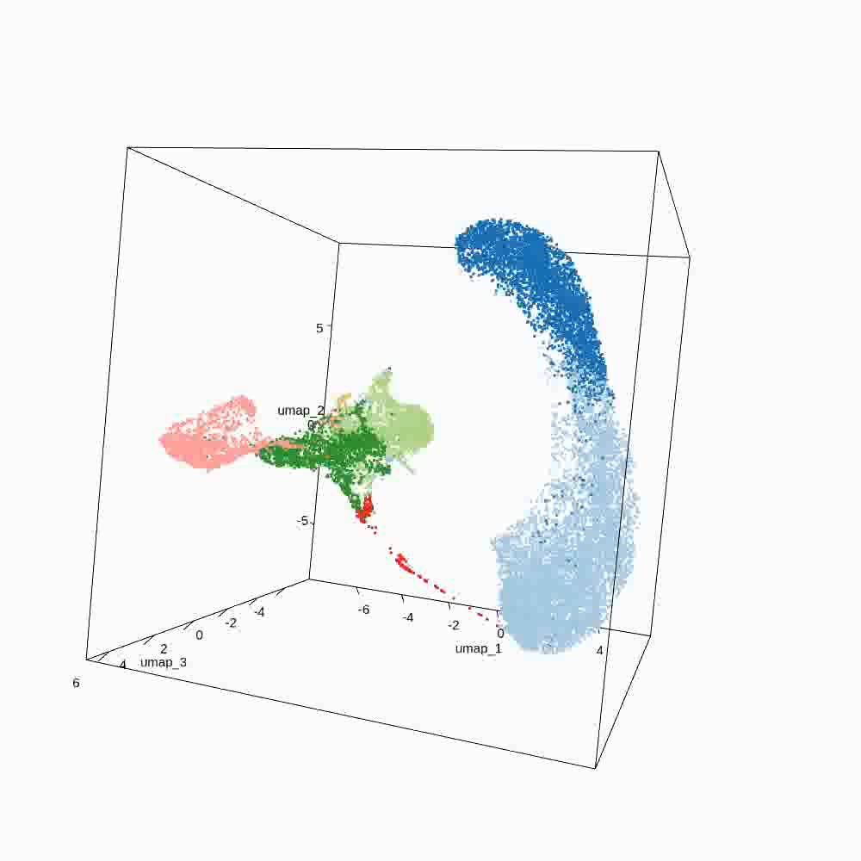
3D presentation of all analyzed cells in 3D-UMAP

Slide 9
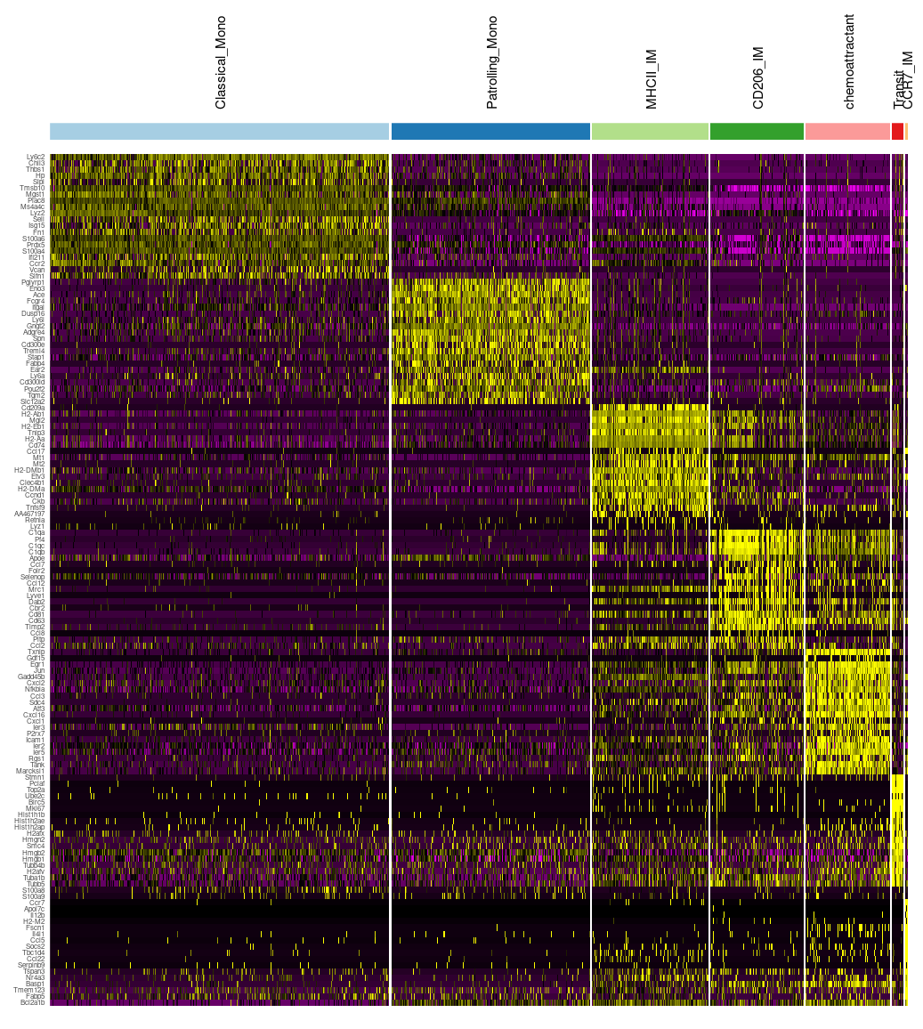
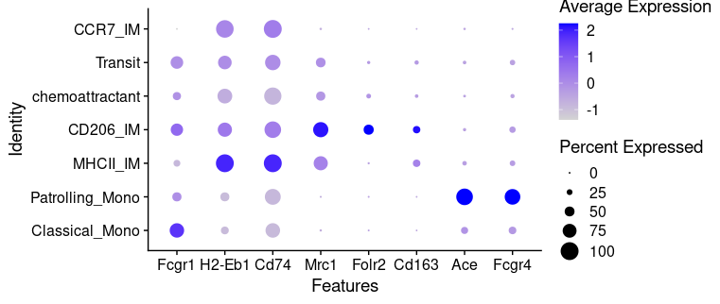
Cell identities

Slide 10
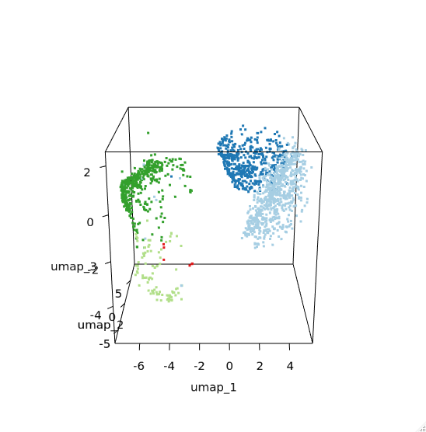
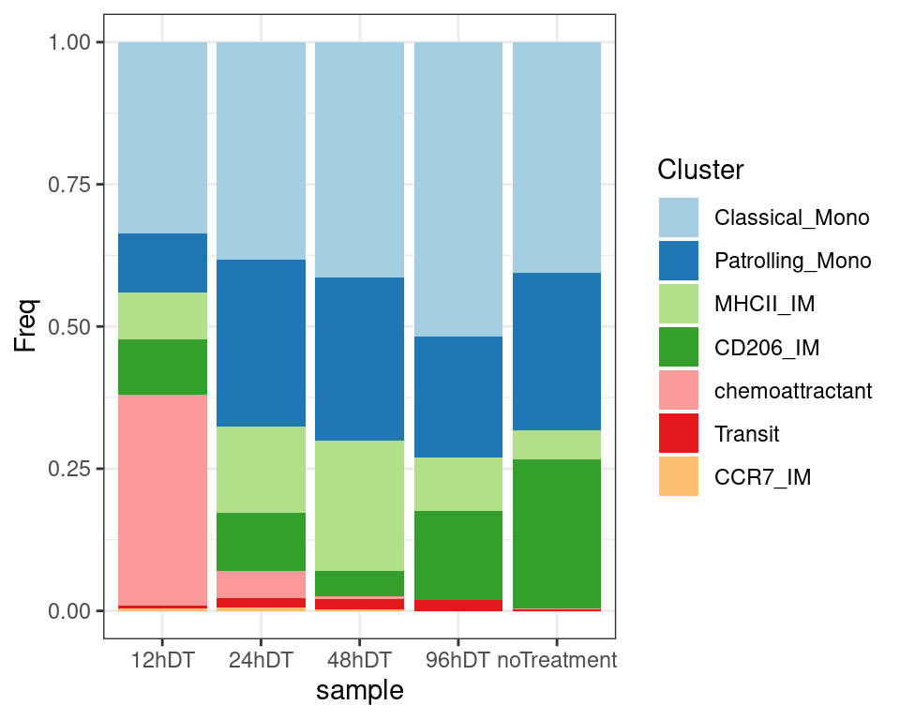
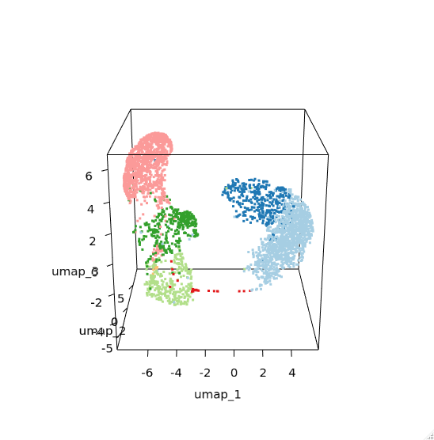
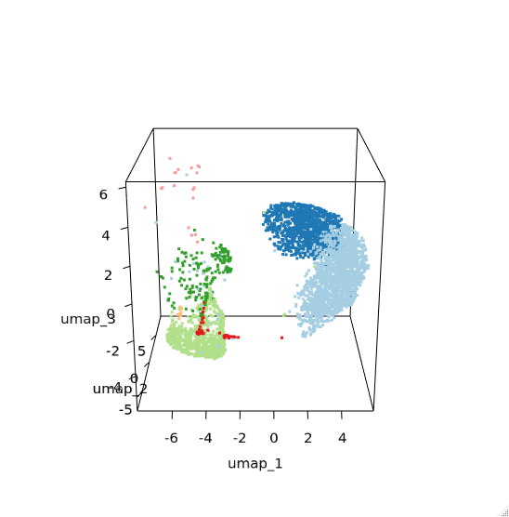
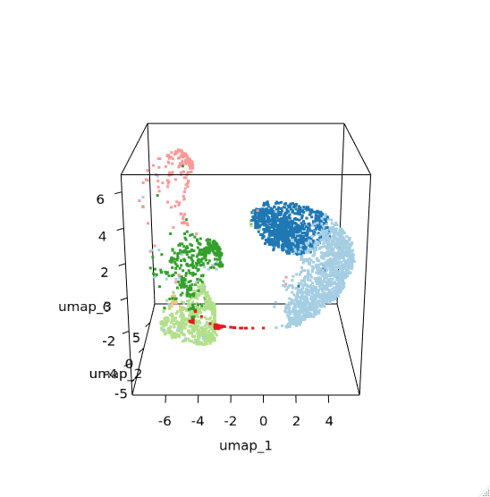
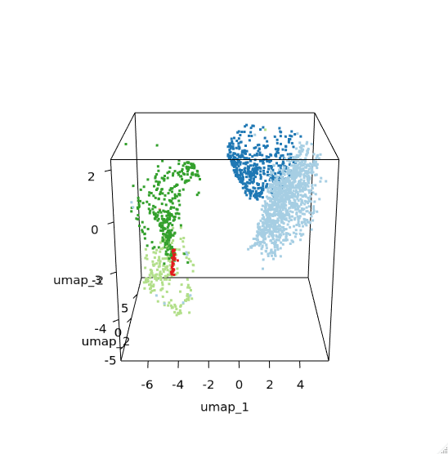
No depletion
Cell composition
DT-12h
DT-48h
DT-24h
DT-96h

Slide 11
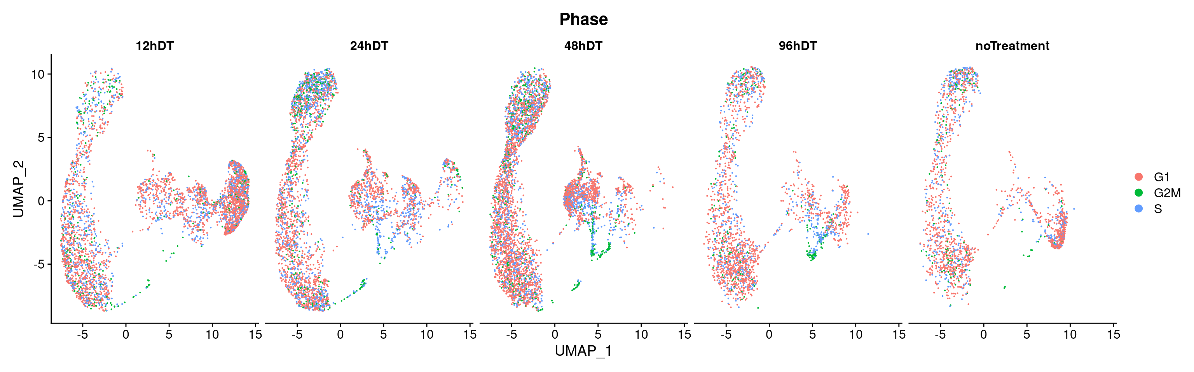
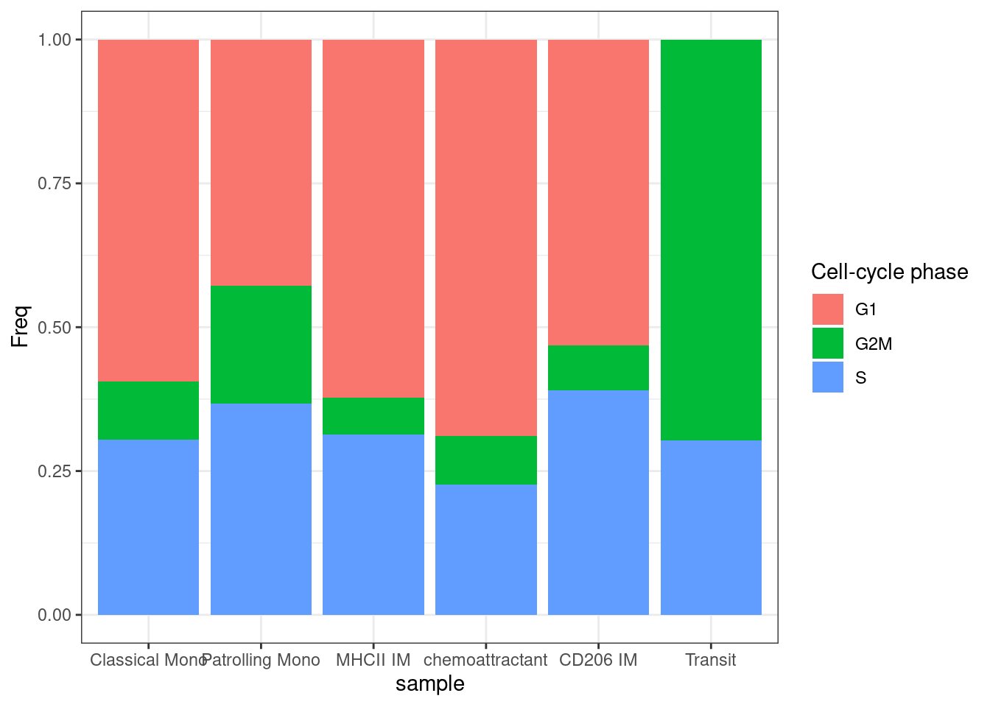
Cell cycle

Slide 12
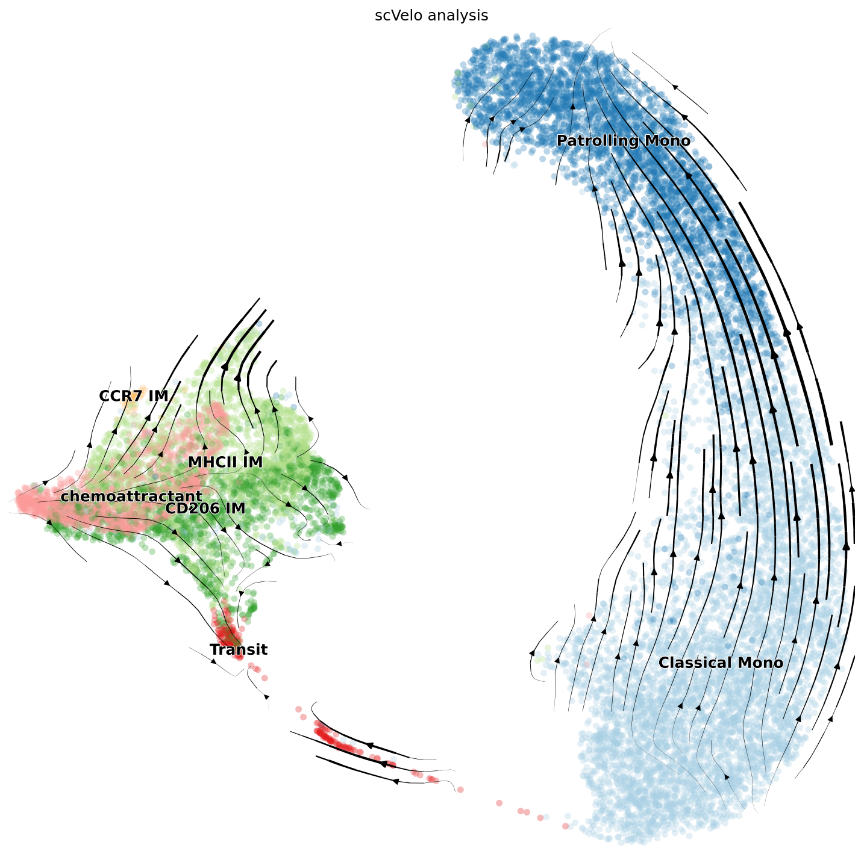
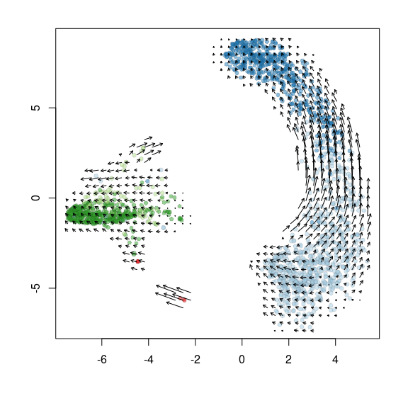
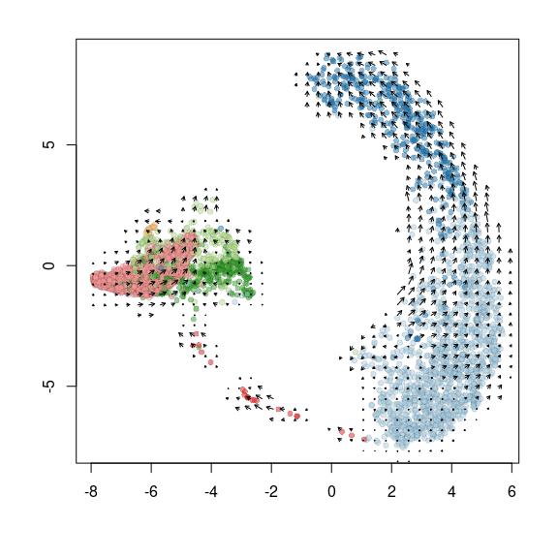
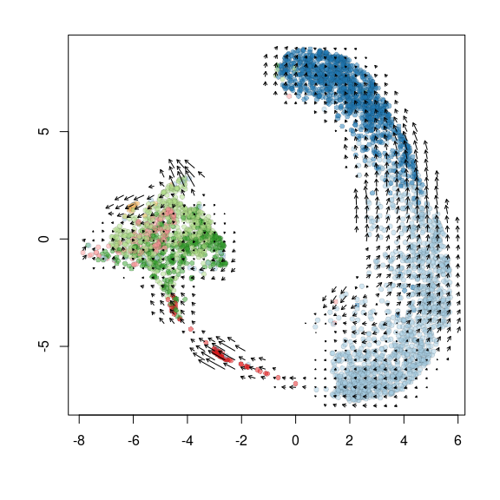
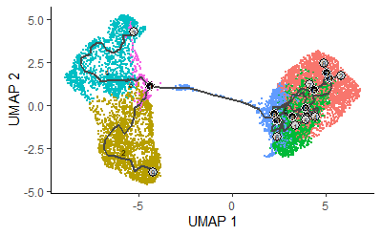
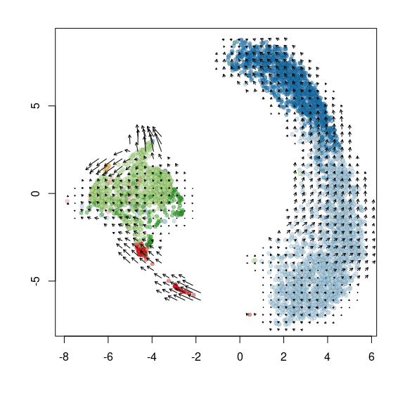
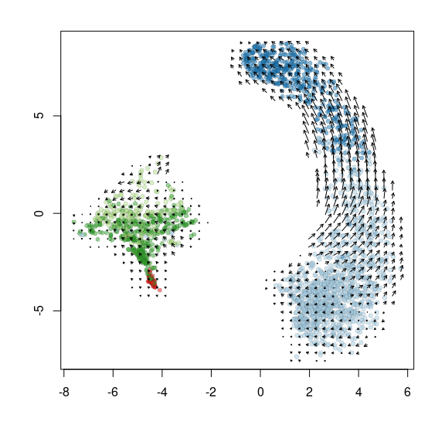
Predict cell fate by single-cell RNA velocity et Monocle
No Treatment
12h DT
24h DT
48h DT
96h DT
RNAvelocity analysis (la Manno et al. 2018. Nature )
Monocle (Qiu et al. 2014. Nat Methods )
Notes:
15

Slide 13
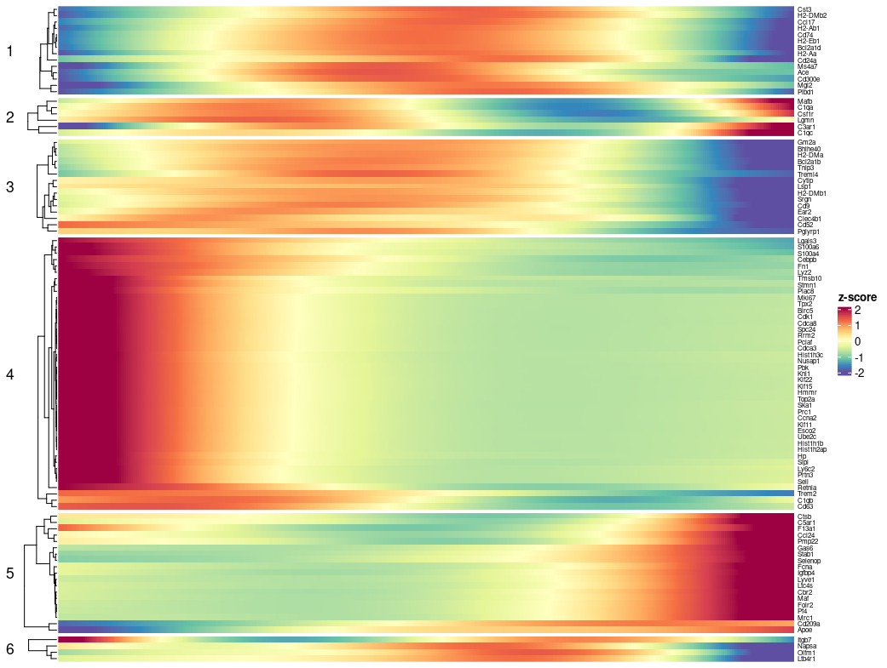
Identification of TF programs that drive monocyte-IM differentiation
From monocytes to IMs (both CD206+ and CD206-)
Monocytes
Pseudotime
IM

Slide 14
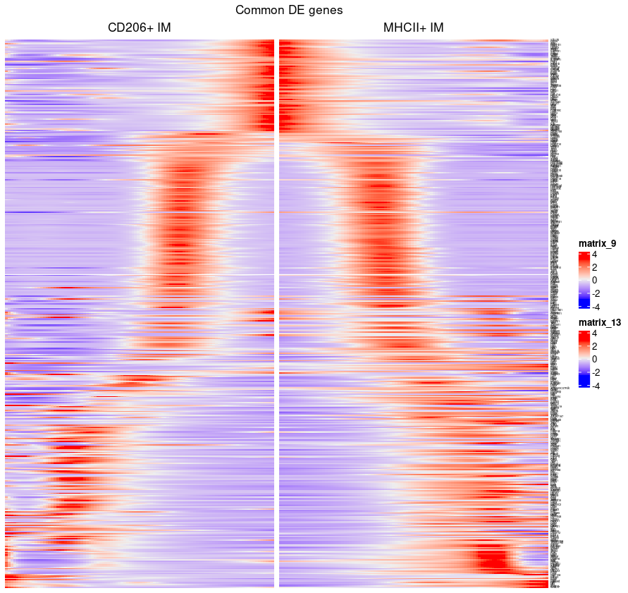
Identification of transcriptional programs that drive IM subset differentiation
Monocyte markers
cycling genes
Macrophage-specific genes
CD206 IM
Monocytes
MHCII IM

Slide 15
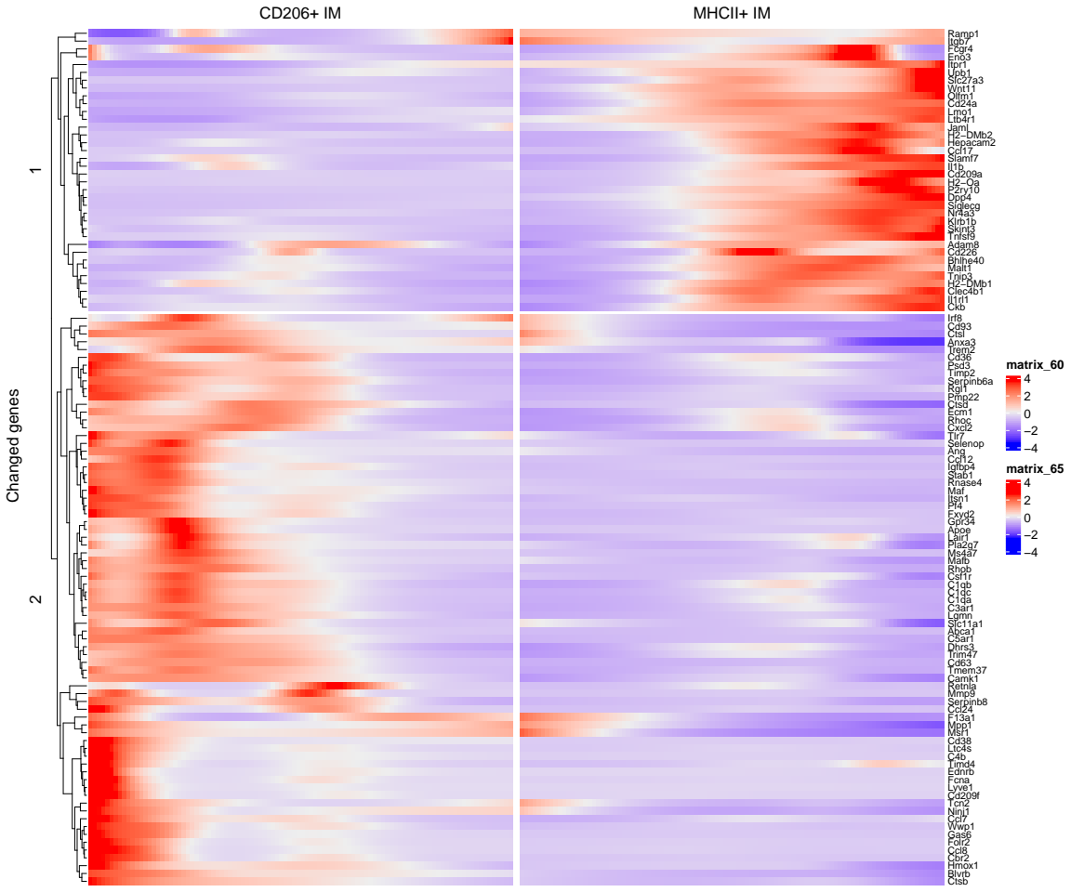
Identification of transcriptional programs that drive IM subset differentiation
Branch-specific DE
MHC-II
Maf
Mafb
C1
Lyve1
CD206 IM
Monocytes
MHCII IM

Slide 16
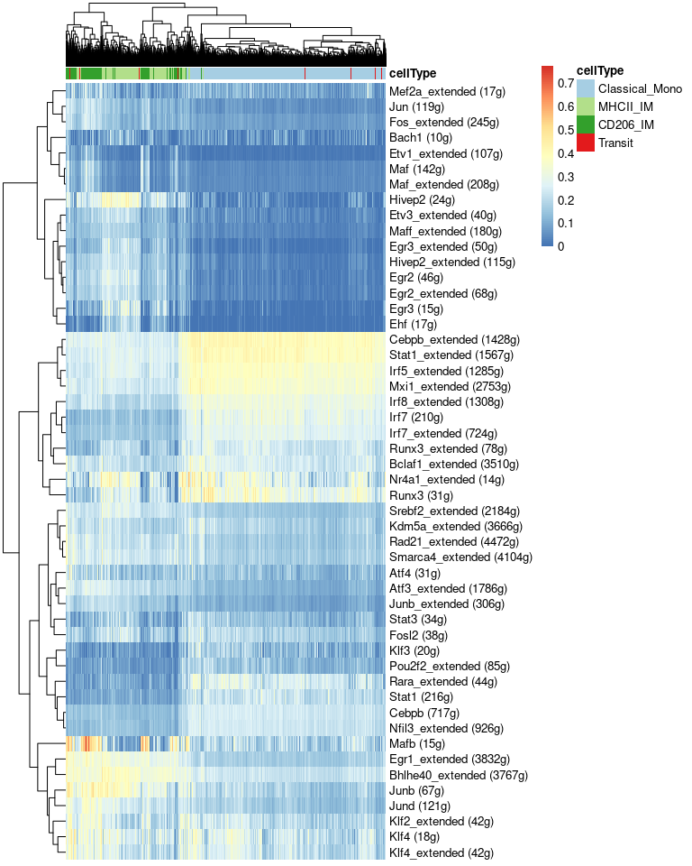
Identification of transcription factors that drive IM subset differentiation
SCENIC analysis (Aibar et al. 2017 Nat Methods)

